Slide 1

Storytelling Case Study: Airbnb, NYC
Ranjith Cheela
Hein Huynh
Raheema

Slide 2
Objective:
Airbnb is an online platform help people to rent their property to the travellers or for the long term stays
Airbnb incurred hefty loss while during Covid
Airbnb started focussing on the trend of travelling again post the covid crisis and thinking to grab this opportunity for the development of the business back
We are here to analyse the properties around NYC region to accommodate the travellers post Covid crisis

Slide 3
Data Preparation
Cleaned data to remove any missing values and duplicates.
Dropped insignificant columns.
Identified outliers

Slide 4
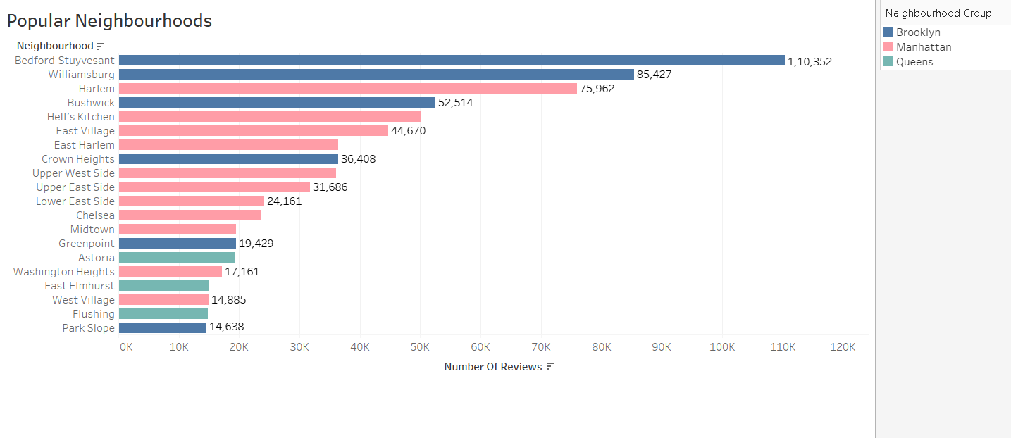
Popular Neighborhoods
We see that Bedford-Stuyvesant from Brooklyn is the highest popular with 1,10,352 no of reviews in total followed by Williamsburg.
Harlem from Manhattan got the highest no of reviews followed by Hell’s kitchen.
The higher number of customer reviews imply higher satisfaction in these localities.

Slide 5
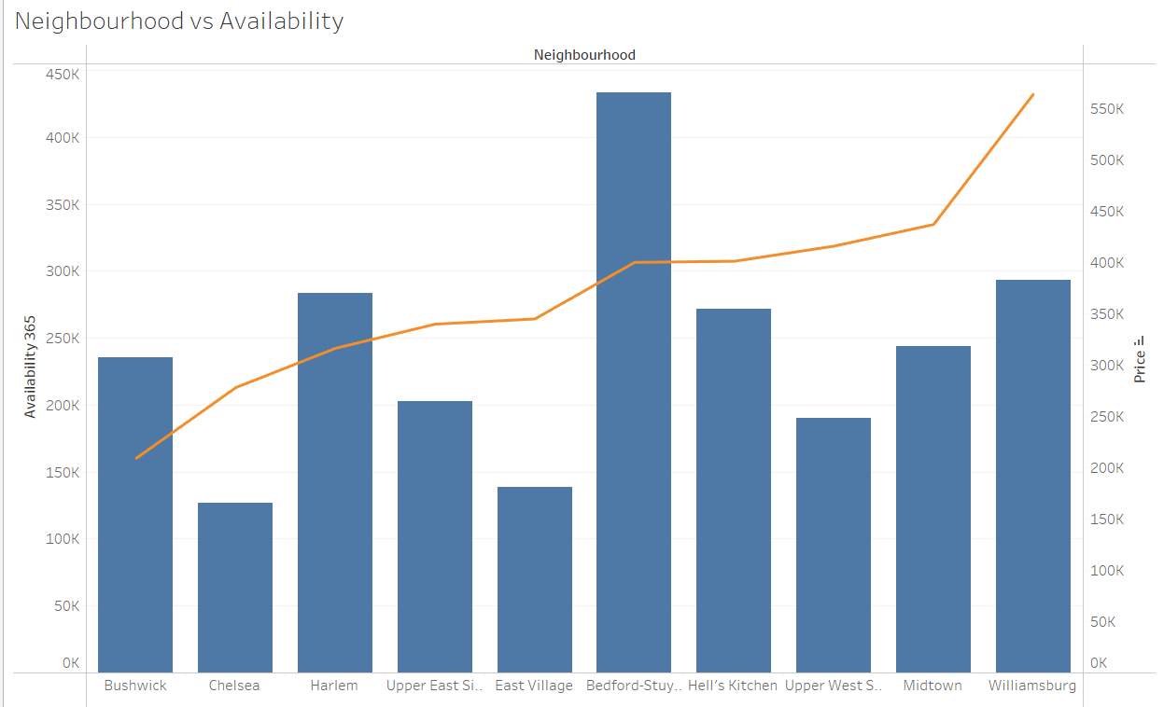
Availability and Price
Bedford-Stuyvesant has the highest availability and price is also high
Followed by Bedford we see the similar kind of trend across Hell’s Kitchen, Williamsburg, and Harlem
Chelsea is the lowest in the availability and price.

Slide 6
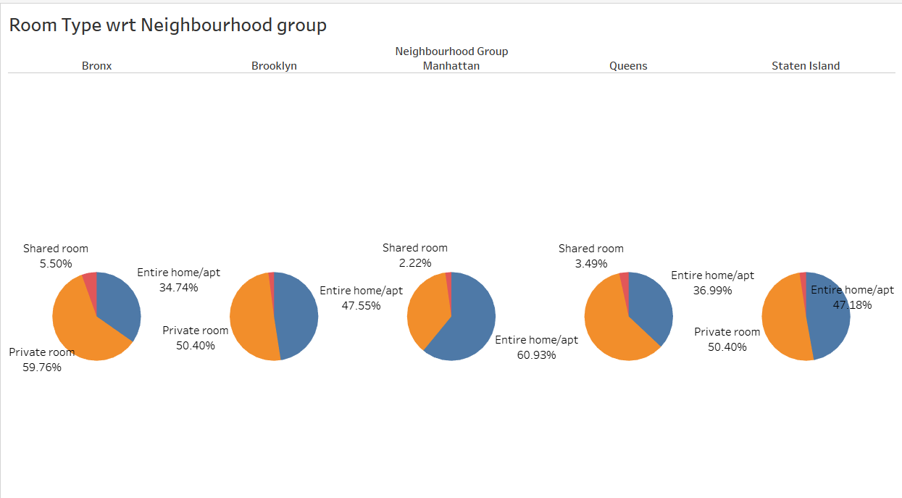
Types of Rooms
People tend to book the entire property in and around Brooklyn and Manhattan in the pie chart we can anlayze what are the listed property percentage
Manhattan has highest number of home/apt properties, i.e. 60.93% of total listed properties.
Maximum number of private rooms are available in Bronx i.e. around 59.76% of total listed properties.
Very less number of shared rooms are available in each Neighbourhood group.

Slide 7
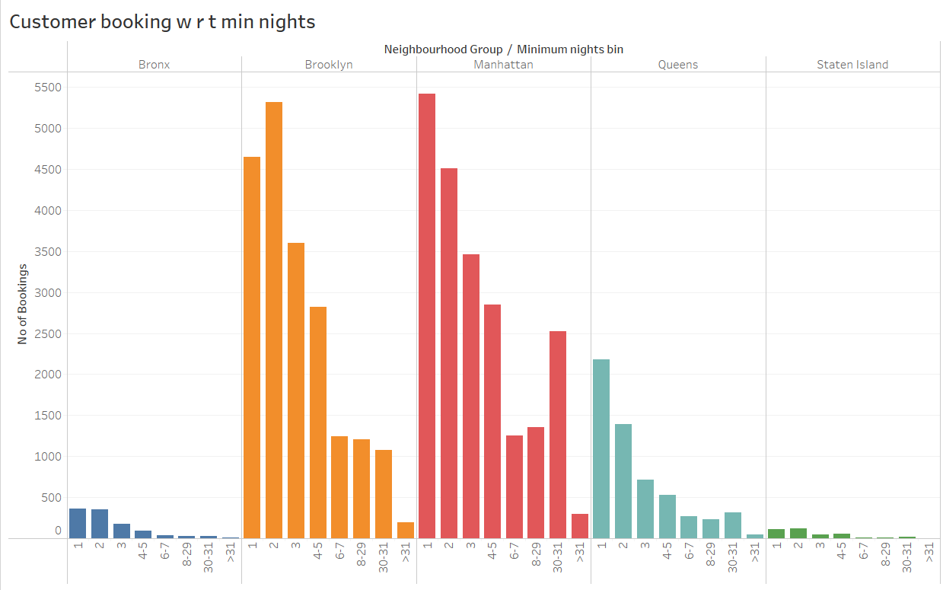
Average days of stay
We can see that the bookings for 1-5 days were more.
Also we can observe the bookings for 30 days were in raise in Brooklyn and Manhattan especially.
Seems like people want to migrate for the longer tenure of holidays.

Slide 8
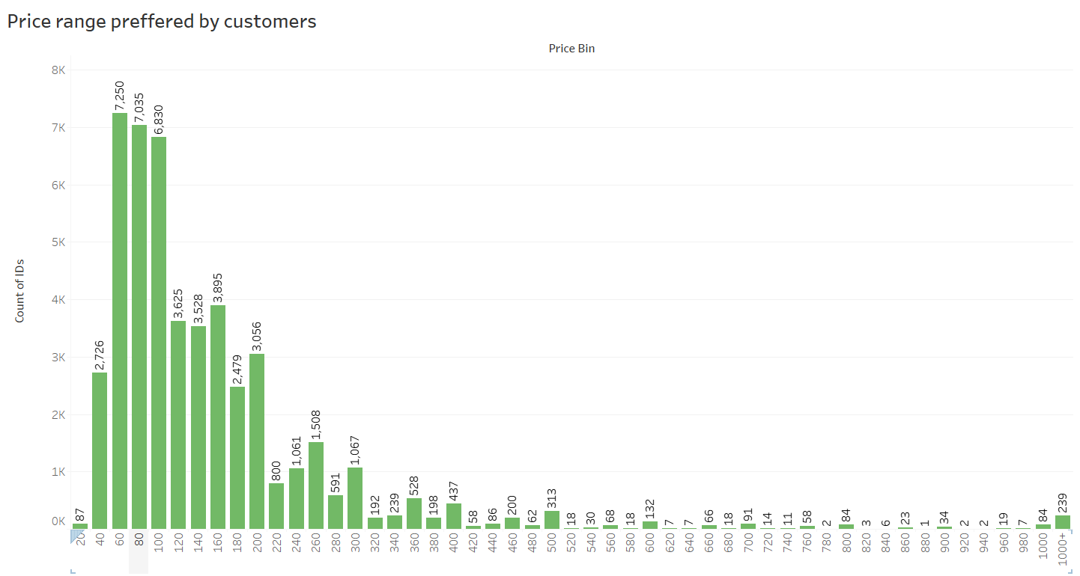
Average Price range of bookings
Based on the volume of bookings done, and their price range is considered
$60 - $200 is the price range is the most preferred

Slide 9
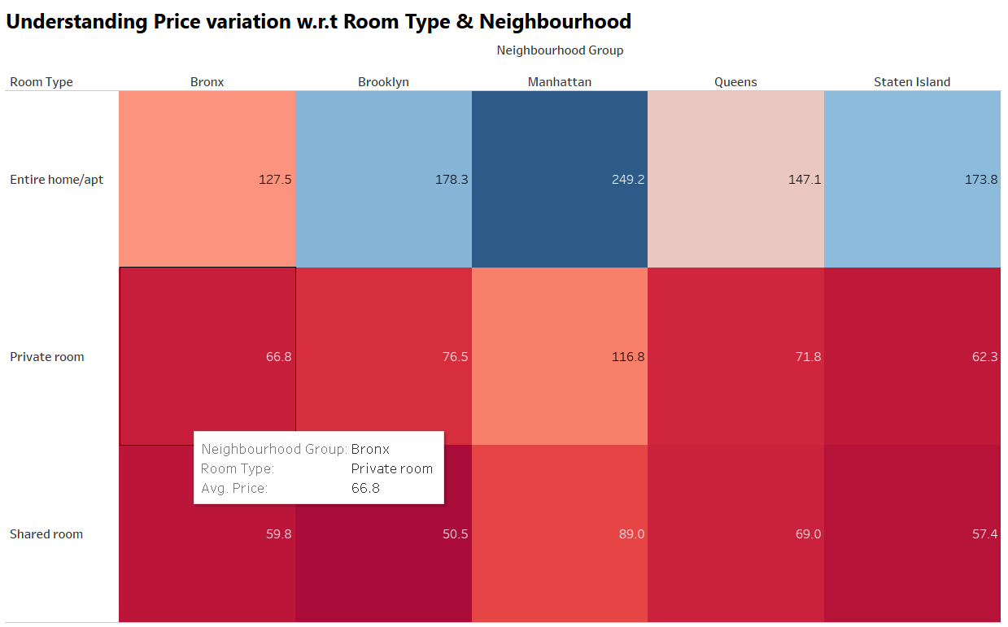
Price variation
The 'Entire home/apt' room type in Manhattan is the most expensive at $250, much higher than the overall average.
Brooklyn and Staten Island stands next to Manhattan on the price for the Entire home/apt
‘private rooms’ of Manhattan & Brooklyn has the highest average.
‘Shared Room' type is the cheapest in Brooklyn with $50.5.

Slide 10
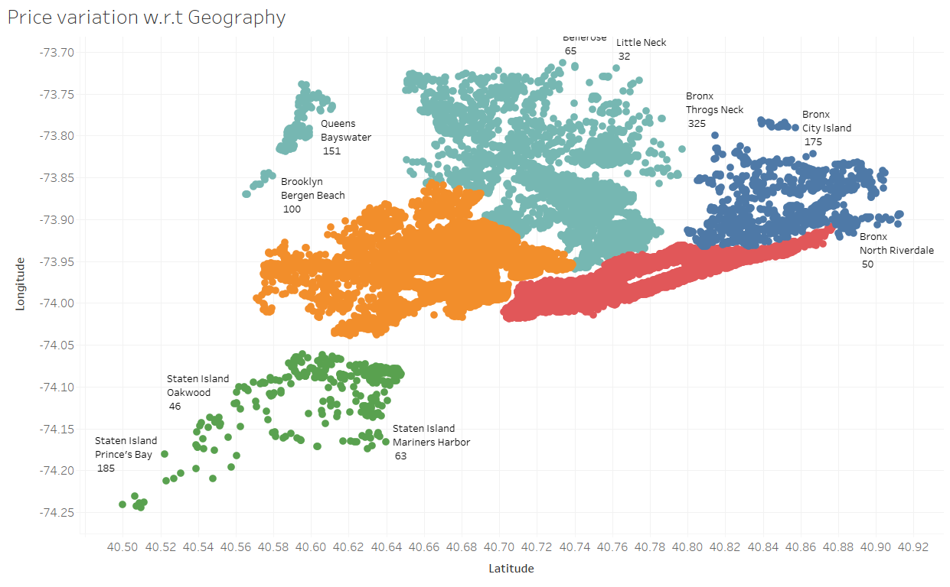
Price vs Geographical location
We see that, Airbnb has good presence in Manhattan, Brooklyn & Queens.
Listings are maximum in Manhattan & Brooklyn owing to the high population density and it being the financial and tourism hub of NYC. Staten Island has the least number of listings, due to its low population density and very few tourism destinations.

